Slide 1
Data consistency in a High Volume system

Slide 2
Transaction Management - Revisited
Transaction management is an important part of RDBMS oriented enterprise applications to ensure data integrity and consistency.
ALL [ Almost] business-related applications require a high degree of data quality.
Financial investment industry wastes tens of billions of dollars on failed trades
Lack of transaction support is a MAJOR factor leading to bad data
Nonexistent or poor transaction support is common
On the other hand
Transaction Management can kill performance, introduce locking issues and database concurrency problems, and add complexity to your application.
Ignorance about transaction support is a significant source of the problem.
Knowledge is Power
Notes:
http://www.ibm.com/developerworks/library/j-ts1/
https://stackoverflow.com/questions/818074/transactions-for-read-only-db-access

Slide 3
Spring Transaction Management
Programmatic Transaction Management
Couples application to Spring’s Transaction API
Good for small number of transactional operations
Not good for maintenance or portability.
Declarative Transaction Management
No dependency on the Spring Transaction API
Least impact on application code
Characteristics of a Non-invasive lightweight container
TransactionManagement Decision
Programmatic Transaction Management
try {
tx = this.getSession().beginTransaction();
query = super.getSession().createQuery("select v from VEHICLE v
where v.vehicleNo =:number");
vehicle = (Vehicle) query.setParameter("number", number).uniqueResult();
tx.commit();
return vehicle;
}
catch (Exception e) {
if (tx!=null) tx.rollback();
throw e;
Notes:
Most Spring Framework users choose declarative transaction management. This option has the least impact on application code, and hence is most consistent with the ideals of a non-invasive lightweight container.
Most users prefer declarative transaction management, which is recommended in most cases.
With programmatic transaction management, developers work with the Spring Framework transaction abstraction, which can run over any underlying transaction infrastructure. With the preferred declarative model, developers typically write little or no code related to transaction management, and hence do not depend on the Spring Framework transaction API, or any other transaction API.
TransactionTemplate:
https://docs.spring.io/spring/docs/4.3.12.RELEASE/spring-framework-reference/htmlsingle/#transaction-programmatic

Slide 4
Declarative Transaction Attributes
Propagation | enum: Propagation | Optional propagation setting.
Isolation | enum: Isolation | Optional isolation level.
ReadOnly | boolean | Read/write vs. read-only transaction
TimeOut | Integer [seconds] | Max Transaction time
only applies to
new transactions.
@Service
@Transactional(propagation=Propagation.REQUIRES_NEW,
isolation=Isolation.READ_COMMITTED)
public class ReadCommittedServiceImpl
implements edu.mum.service.ReadCommittedService {

Slide 5
Propagation Values
PROPAGATION TYPE | No Transaction | Transaction exists
MANDATORY | throw exception | use current transaction
NEVER | Run method | throw exception
NOT_SUPPORTED | Run method | Suspend current transaction, run method outside transaction
SUPPORTS | Run method | Use current transaction
REQUIRED (default) | Create a transaction | Use current transaction
REQUIRES_NEW | Create a transaction | Suspend current transaction, create a new independent transaction
NESTED | create a transaction | create a new nested transaction inside current transaction
Notes:
all code executed within a transaction scope will run in that transaction. However, you have the option of specifying the behavior in the event that a transactional method is executed when a transaction context already exists. For example, code can continue running in the existing transaction (the common case); or the existing transaction can be suspended and a new transaction created.
REQUIRES_NEW USE CASE
For example, suppose that every stock trade that was attempted had to be recorded in an audit database. This information needs to be persisted whether or not the trade failed because of validation errors, insufficient funds, or some other reason.
Defaults to Isolation.DEFAULT. Use the default isolation level of the underlying datastore.
Exclusively designed for use with Propagation.REQUIRED or Propagation.REQUIRES_NEW since it only applies to newly started transactions.
The transaction propagation type.Defaults to Propagation.REQUIRED.
Propagation.NESTED.
The nested transaction is part of of the outer transaction, so it will only be committed at the end of of the outer transaction.

Slide 6
ACID Database properties
Set of properties that guarantee that database transactions are processed reliably.
ATOMIC: The transaction is considered a single unit, either the entire transaction completes, or the entire transaction fails.
CONSISTENT: A transaction transforms the database from one consistent state to another consistent state
ISOLATED: Data inside a transaction can not be changed by another concurrent processes until the transaction has been committed
DURABLE: Once committed, the changes made by a transaction are persistent
Atomicity and Durability are strict properties,
i.e., Black or White, All or None
Consistency and Isolation are “configurable”
&
Interdependent

Slide 7
Isolation in a Relational Database
The challenge is to maximize concurrent transactions, while maintaining consistency
The shorter the lock acquisition interval, the more requests a database can process.
Spring Isolation Levels:
SERIALIZABLE (NO dirty, non-repeatable OR phantom reads)
REPEATABLE READ (NO dirty OR non-repeatable reads)
READ COMMITTED (NO dirty reads)
READ UNCOMMITTED (ANYTHING Goes)
Most databases default to READ COMMITTED
Spring @Transactional isolation enum reflects these values
Isolation.DEFAULT – uses DB level
Notes:
Uncommitted violates EVERYTHING concerning ACID
REPEATABLEread for reportng …Aggregate “services, etc…
https://dev.mysql.com/doc/refman/5.7/en/innodb-transaction-isolation-levels.html
https://dev.mysql.com/doc/refman/5.7/en/set-transaction.html TRANSACTION SYNTAX
mySQL defaults to repeatable read
SQL SERVER, ORACLE read committed
Defaults to Isolation.DEFAULT. Use the default isolation level of the underlying datastore.
Exclusively designed for use with Propagation.REQUIRED or Propagation.REQUIRES_NEW since it only applies to newly started transactions.

Slide 8
Spring Isolation Types
 | dirty reads | non-repeatable reads | phantom reads
READ_UNCOMMITTED | yes | yes | yes
READ_COMMITTED | no | yes | yes
REPEATABLE_READ | no | no | yes
SERIALIZABLE | no | no | no

Slide 9
Transaction Read Phenomena
The ANSI/ISO standard SQL 92 refers to three different read phenomena when Transaction A reads data that Transaction B might have changed.
Dirty Read
Transaction B is allowed to read data from a row that has
been modified by Transaction A and not yet committed
If Transaction A rolls back, Transaction B has “bad” data.
Non-repeatable read
Transaction A reads a row twice. Transaction B modifies
the row between reads.Transaction A gets inconsistent data
Phantom read
Transaction A fetches a collection twice. Transaction B
modifies the collection between fetches. Transaction A gets
inconsistent data See Demos
Notes:
Non-repeatable read
a row is retrieved twice and the values within the row differ between reads.

Slide 10
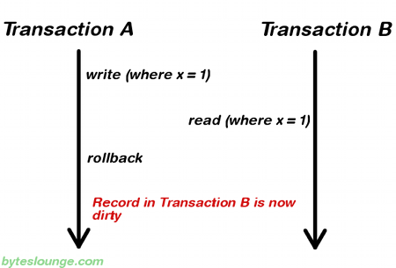
DIRTY READ
Transaction B is allowed to read data from a row that has
been modified by Transaction A and not yet committed
NOTE: “x” is entity Primary key
Notes:
http://www.byteslounge.com/tutorials/spring-transaction-isolation-tutorial

Slide 11
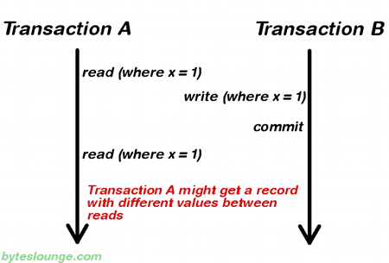
Non Repeatable Read
Transaction A reads a row twice. Transaction B modifies
the row between reads. Transaction A gets inconsistent data
NOTE: “x” is entity Primary key
Notes:
Non-repeatable read
a row is retrieved twice and the values within the row differ between reads.

Slide 12
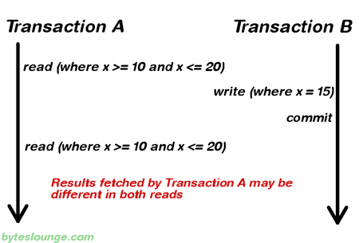
Phantom Read
Transaction A fetches a collection twice. Transaction B modifies the
collection between fetches. Transaction A gets inconsistent data

Slide 13
Lock Mode for Data Consistency
Locking refers to actions taken to prevent data in a relational database from changing between the time it is read and the time that it is used.
Locking strategies
Optimistic Lock
Concurrent transactions can complete without affecting each other,
Transactions do not need to lock the data resources that they affect.
Pessimistic Lock
Concurrent transactions will conflict with each other
Transactions require that data is locked when read and unlocked at commit.
Notes:
If many different applications access your data you may be best off using a column automatically updated by the database. e.g. for MySQL
version TIMESTAMP DEFAULT CURRENT_TIMESTAMP ON UPDATE CURRENT_TIMESTAMP;

Slide 14
Version-Based Optimistic Concurrency[Locking]
High-volume systems
No Connection maintained to the Database [Detached Objects]
Effective in Read-Often Write-Sometimes scenario
  Uses read committed isolation level
Guarantees repeatable read -like isolation level
An exception is thrown if a conflict occurs
Uses Annotation:
@Version Long version;
When entity is updated - version field is incremented.
Used to Identify conflicts..
Transaction A[Tx A] loads data; ends transaction
Transaction B updates that data and commits
“Tx A” process “reads” from detached object
3.a IF “Tx A” updates detached object & object is stale
[Throws Exception]
In “some way” it’s comparable to non-repeatable reads…
…By totally avoiding the second read from DB [3.]
Notes:
Read then detach – repeatable read [.i.e. not affected by DB -- >>>
JPA supports using an optimistic locking version field that gets updated on each update. The field can either be numeric or a timestamp value. A numeric value is recommended as a numeric value is more precise, portable, performant and easier to deal with than a timestamp.“
This strategy is most applicable to high-volume systems and three-tier architectures where you do not necessarily maintain a connection to the database for your session.
If many different applications access your data you may be best off using a column automatically updated by the database. e.g. for MySQL
https://www.intertech.com/Blog/versioning-optimistic-locking-in-hibernate/
Using a timestamp
some DBA’s may prefer to have the version controlled by database rather than Hibernate, especially when the database may be a timestamp and the application is distributed to multiple systems (maybe even timezones).

Slide 15
Version-Based Optimistic Concurrency
Optimistic concurrency assumes that update conflicts generally don’t occur
  Keeps version #s so that it knows when they do
  Guarantees best performance and scalability
  The default way to deal with concurrency
  There is no locking anywhere
  It works well with very long conversations, including those that span multiple transactions
First commit wins instead of last commit wins
  An exception is thrown if a conflict would occur
ObjectOptimisticLockingFailureException

Slide 16
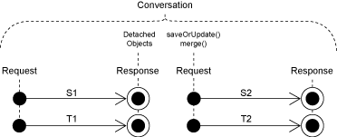
Optimistic Locking [ Cont.]
  It works well with long conversations, including those that span multiple transactions
LONG CONVERSATION Use Case:
A multi-step dialog, for example a wizard dialog interacts with the user
in several request/response cycles.
session-per-request-with-detached-objects
@Version Locking manages
detached object consistency

Slide 17
JPA Optimistic Locking
JPA version-based concurrency control
Simply add @Version to an Integer field – JPA takes care of the rest
@Id
@GeneratedValue(strategy = GenerationType.AUTO)
private Long id = null;
@Version
@Column(name = "version")
private int version = 0;
Hibernate:
update purchaseOrder
set orderNumber=?,version=? [increment version ]
where id=? and version=? [if detached version=DB version]
@Version property is incremented on every DB write
Checked for consistency on every update
Notes:
it will read the record in order to know the current VERSION value, and then it will use the value in the update statement in a couple of ways: it will increment the VERSION to the next value and will also check if the current VERSION is still the same that it has read in the first place
Mysql select now() -- gets current data & time

Slide 18
Main Point
A unit of work is a representation of a process that is only considered when all its parts are complete.
Science of Consciousness: Wholeness is greater than the sum of the parts.

